Slide 1


How to Write an Academic Paper
Michele C. Weigle and Michael L. Nelson
CS 891 – Web Archiving Seminar
Fall 2017
@WebSciDL
https://phonedude.github.io/cs891-f17/

Slide 2
What is a PhD?
A PhD program is very different from getting a Bachelor’s degree, and you must treat it as a strange type of job.
Initiative, tenacity, flexibility, interpersonal skills, organizational skills, and communication skills are all critical and not things that universities typically test for in selecting incoming students.
http://www.cs.unc.edu/~azuma/hitch4.html

Slide 3
Communication Skills
You will write (a lot)
You will present your ideas (a lot)
It will be so much better (and more efficient) for all of us if we spend more time talking about research ideas than about organization, grammar, and typos
I cannot over-emphasize how important this is
http://www.cs.unc.edu/~azuma/hitch4.html

Slide 4
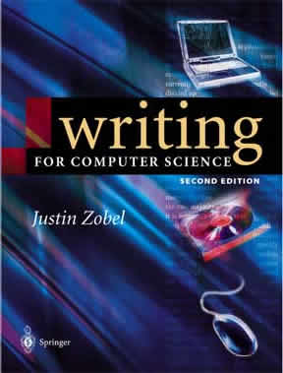
Main Resources
Writing for Computer Science by Justin Zobel
The Elements of Style by Strunk and White

Slide 5
Today's Focus
What I'll talk about
organization/structure
citations and references
the writing process
style comments
What I won't talk about
grammar – see Strunk and White

Slide 6
Writing a paper is a lot like telling a story.
http://www.brunswick.k12.me.us/hdwyer/files/2011/11/storyboarding-freytags-pyramid.jpg

Slide 7
Most academic papers look similar
Abstract
Introduction – exposition -> rising action
Related Work – rising action
Approach - climax
Evaluation/Results – climax -> falling action
Future Work and Conclusions - denouement
http://www.brunswick.k12.me.us/hdwyer/files/2011/11/storyboarding-freytags-pyramid.jpg

Slide 8
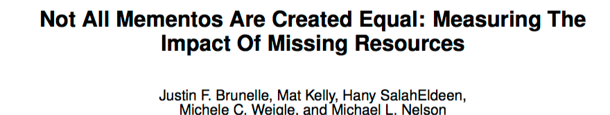
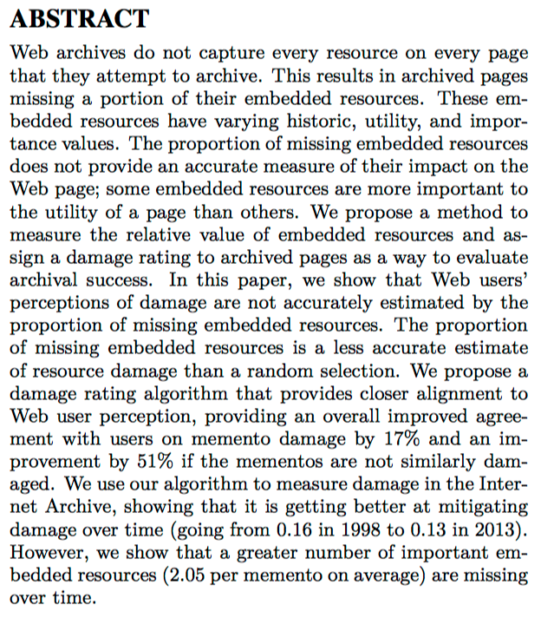
JCDL 2014
Best Student Paper
problem
approach
results!

Slide 9
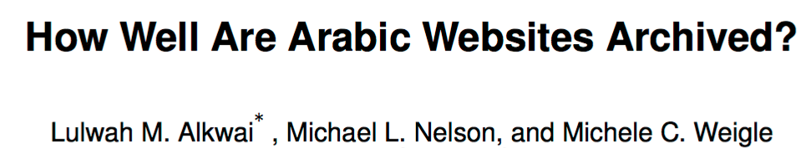
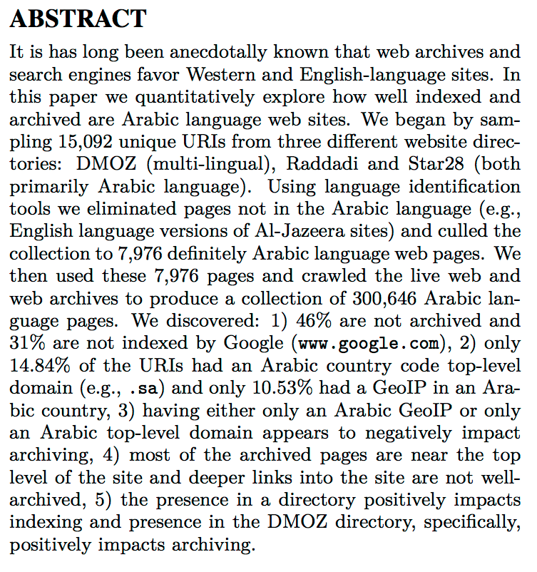
problem
JCDL 2015
Best Student Paper
approach
results!

Slide 10
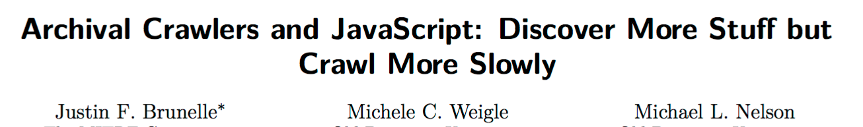
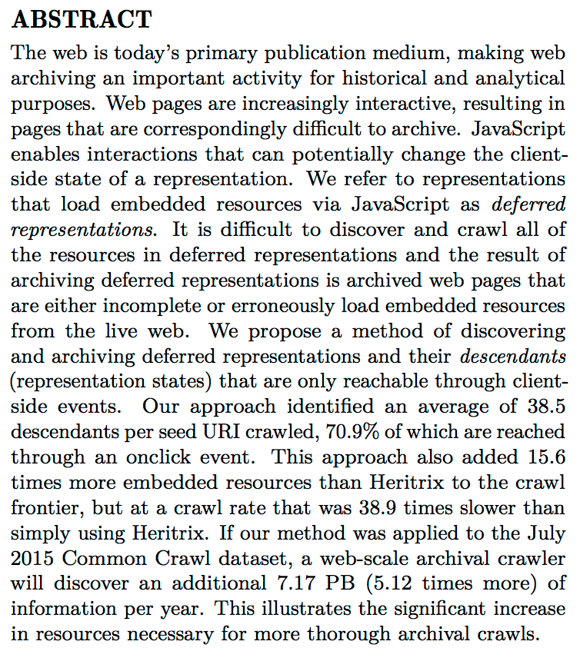
JCDL 2017
problem
approach
results!

Slide 11
What do these abstracts have in common?

Slide 12
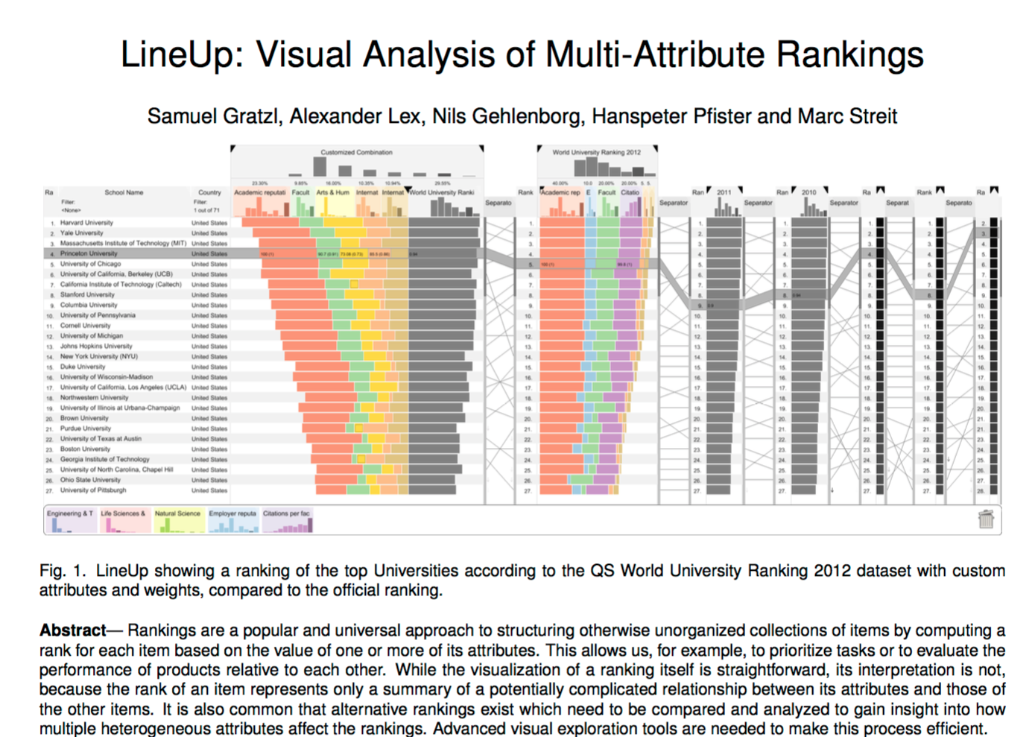
Vis papers often have a teaser image
InfoVis 2013
Best Paper

Slide 13
Introduction
Set up
introduce the broad research area being investigated
Provide an example of the specific problem for motivation
it’s not too early for a figure or illustrative screenshot
Brief statement of why existing approaches don't solve the problem
Outline of proposed approach
Summary of the results
Highlight the paper’s contributions
don't be shy

Slide 14
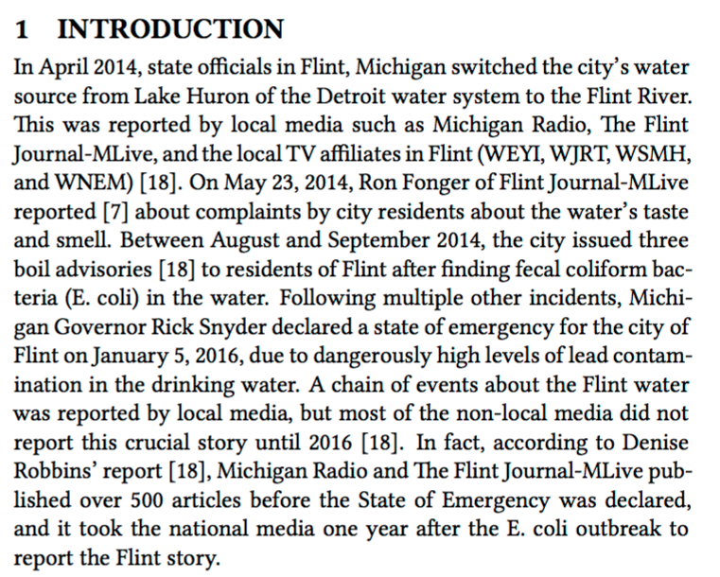
Set-up
Motivation
Alexander C. Nwala, Michele C. Weigle, Michael L. Nelson, Adam B. Ziegler and Anastasia Aizman, "Local Memory Project: Providing Tools to Build Collections of Stories for Local Events from Local Sources," In Proceedings of the ACM/IEEE Joint Conference on Digital Libraries (JCDL). Toronto, Ontario, Canada, June 2017.

Slide 15
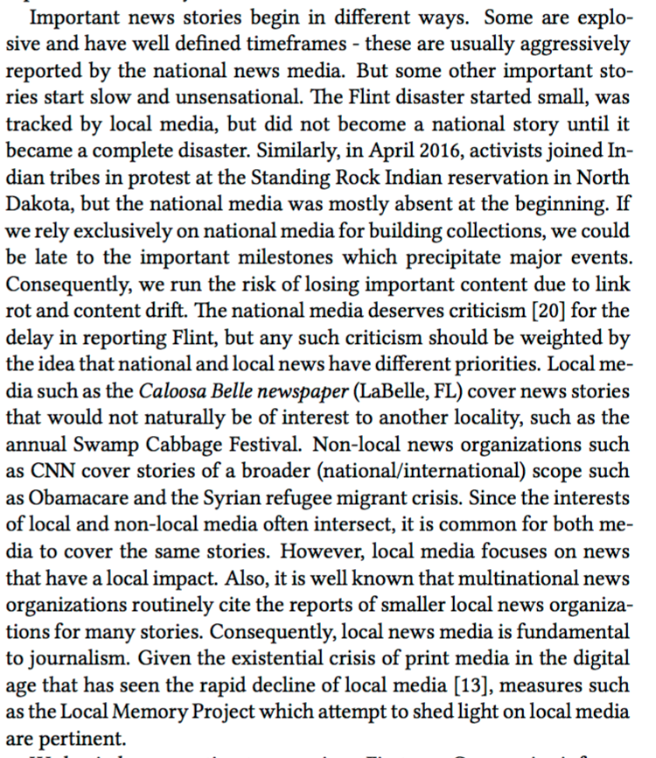
Existing approaches don't solve the problem
Alexander C. Nwala, Michele C. Weigle, Michael L. Nelson, Adam B. Ziegler and Anastasia Aizman, "Local Memory Project: Providing Tools to Build Collections of Stories for Local Events from Local Sources," In Proceedings of the ACM/IEEE Joint Conference on Digital Libraries (JCDL). Toronto, Ontario, Canada, June 2017.

Slide 16
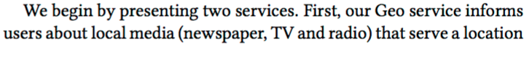
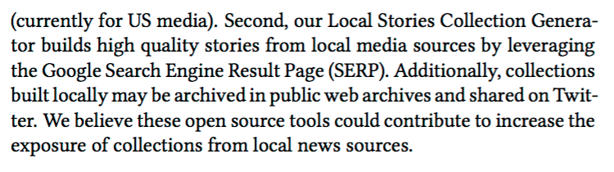
Outline of proposed approach
Contributions
Alexander C. Nwala, Michele C. Weigle, Michael L. Nelson, Adam B. Ziegler and Anastasia Aizman, "Local Memory Project: Providing Tools to Build Collections of Stories for Local Events from Local Sources," In Proceedings of the ACM/IEEE Joint Conference on Digital Libraries (JCDL). Toronto, Ontario, Canada, June 2017.

Slide 17
Related Work
Overview of work that is similar to yours
How does your work builds upon previous work?
How are those works are different? Do they solve a different problem than yours?
https://www.wiltgren.com/2015/06/12/where-does-influenced-by-become-stealing-a-design/

Slide 18
Approach
Describe what you did
Methods, algorithms, datasets, experiments
The ideal goal is reproducibility

Slide 19
Evaluation/Results
Describe how you evaluated your approach
compare to other approaches
test on multiple types/sizes of data
It’s likely that most of your figures will go in this section

Slide 20
I’ll always comment on your figures
Remember your CS 725/825 principles
don't make the reader work too hard to understand your chart
every chart must have descriptive (and large) x and y axis labels with units
Every figure must be referenced in the main body text.
Each figure must have an informative caption.
not too long, not too short
if you use a figure from another source, cite the reference in the caption

Slide 21
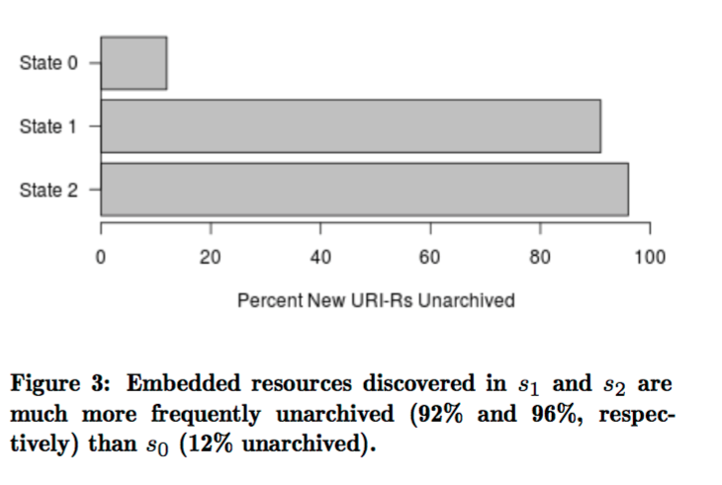
Justin F. Brunelle, Michele C. Weigle and Michael L. Nelson, "Archival Crawlers and JavaScript: Discover More Stuff but Crawl More Slowly," In Proceedings of the ACM/IEEE Joint Conference on Digital Libraries (JCDL). Toronto, Ontario, Canada, June 2017.

Slide 22
Future Work and Conclusions
Consider how your work could be improved or applied in different contexts
don’t be afraid to talk about limitations
Conclusions summarize the problem, approach, and results
don’t introduce new information here

Slide 23
Citations and References

Slide 24
The citation label is not a noun.
The sentence should still make sense even if it is removed
Bad
In [5], Banos et al. created an algorithm
[25] and [26] are page-at-a-time archival tools
Good
Banos et al. [5] created an algorithm
Browsertrix [25] and WebRecorder.io [26] are page-at-a-time archival tools
In previous work [12], we assigned

Slide 25
Citation Style
et al. ("and others") is an abbreviation
et means "and" – so, no period
al. is an abbreviation for alii, meaning "others"
Citation label goes next to the name of the authors or the work or idea
Good: Banos et al. [5] created an algorithm to evaluate …
Bad: Banos et al. created an algorithm to evaluate … of assigning an archivability score to a URI-R [5].

Slide 26
References
There’s a reason there will be multiple slides on this.
Sloppy and inconsistent reference lists drive me crazy.
shows a lack of attention to detail

Slide 27
Bibtex is your friend - Journal
S. M. Jones, H. Van de Sompel, H. Shankar, M. Klein, R. Tobin, and C. Grover, “Scholarly context adrift: Three out of four URI references lead to changed content,” PLoS ONE, vol. 11, no. 12, 2016.
@ARTICLE{jones-plosone2016,
AUTHOR = {Shawn M. Jones and Herbert {Van de Sompel} and Harihar Shankar and Martin Klein and Richard Tobin and Claire Grover},
TITLE = {Scholarly Context Adrift: Three out of Four {URI} References Lead to Changed Content},
JOURNAL = {{PLoS ONE}},
VOLUME = {11},
NUMBER = {12},
DOI = {10.1371/journal.pone.0167475},
YEAR = {2016}
}

Slide 28
Bibtex is your friend - Journal
S. M. Jones, H. Van de Sompel, H. Shankar, M. Klein, R. Tobin, and C. Grover, “Scholarly context adrift: Three out of four URI references lead to changed content,” PLoS ONE, vol. 11, no. 12, 2016.
@ARTICLE{jones-plosone2016,
AUTHOR = {Shawn M. Jones and Herbert {Van de Sompel} and Harihar Shankar and Martin Klein and Richard Tobin and Claire Grover},
TITLE = {Scholarly Context Adrift: Three out of Four {URI} References Lead to Changed Content},
JOURNAL = {{PLoS ONE}},
VOLUME = {11},
NUMBER = {12},
DOI = {10.1371/journal.pone.0167475},
YEAR = {2016}
}

Slide 29
Bibtex is your friend - Conference
K. Padia, Y. AlNoamany, and M. C. Weigle, “Visualizing digital collections at Archive-It,” in Proceedings of the ACM/IEEE Joint Conference on Digital Libraries (JCDL), pp. 15–18, June 2012.
@INPROCEEDINGS{padia-jcdl12,
AUTHOR = { Kalpesh Padia and Yasmin AlNoamany and Michele C. Weigle },
TITLE = { Visualizing Digital Collections at {Archive-It}},
BOOKTITLE = { Proceedings of the ACM/IEEE Joint Conference on Digital Libraries (JCDL) },
YEAR = { 2012 },
MONTH = { June },
PAGES = { 15--18 },
DOI = { 10.1145/2232817.2232821 }
}

Slide 30
Bibtex is your friend – for consistency
@String{jcdl = "Proceedings of the ACM/IEEE Joint Conference on Digital Libraries (JCDL)"}
...
@INPROCEEDINGS{padia-jcdl12,
AUTHOR = { Kalpesh Padia and Yasmin AlNoamany and Michele C. Weigle },
TITLE = { Visualizing Digital Collections at {Archive-It}},
BOOKTITLE = jcdl,
YEAR = { 2012 },
MONTH = { June },
ADDRESS = { Washington, DC },
PAGES = { 15--18 },
DOI = { 10.1145/2232817.2232821 }
}

Slide 31
Edit any BibTeX you get online
@inproceedings{Padia:2012:VDC:2232817.2232821,
author = {Padia, Kalpesh and AlNoamany, Yasmin and Weigle, Michele C.},
title = {Visualizing Digital Collections at Archive-it},
booktitle = {Proceedings of the 12th ACM/IEEE-CS joint conference on Digital Libraries},
series = {JCDL '12},
year = {2012},
isbn = {978-1-4503-1154-0},
location = {Washington, DC, USA},
pages = {15--18},
numpages = {4},
url = {http://doi.acm.org/10.1145/2232817.2232821},
doi = {10.1145/2232817.2232821},
acmid = {2232821},
publisher = {ACM},
address = {New York, NY, USA}}
From ACM Digital Library
Kalpesh Padia, Yasmin AlNoamany, and Michele C. Weigle. 2012. Visualizing digital collections at archive-it. In Proceedings of the 12th ACM/IEEE-CS joint conference on Digital Libraries (JCDL '12). ACM, New York, NY, USA, 15-18. DOI=http://dx.doi.org/10.1145/2232817.2232821

Slide 32
Edit any BibTeX you get online
@inproceedings{Padia:2012:VDC:2232817.2232821,
author = {Padia, Kalpesh and AlNoamany, Yasmin and Weigle, Michele C.},
title = {Visualizing Digital Collections at {Archive-It}},
booktitle = {Proceedings of the 12th ACM/IEEE-CS Joint Conference on Digital Libraries (JCDL)},
series = {JCDL '12},
year = {2012},
isbn = {978-1-4503-1154-0},
location = {Washington, DC, USA},
pages = {15--18},
numpages = {4},
url = {http://doi.acm.org/10.1145/2232817.2232821},
doi = {10.1145/2232817.2232821},
acmid = {2232821},
publisher = {ACM},
address = {New York, NY, USA}}
Including “the 12th” is ok, but prevents the use of @String (every year gets a different ordinal)
Kalpesh Padia, Yasmin AlNoamany, and Michele C. Weigle. 2012. Visualizing digital collections at Archive-It. In Proceedings of the 12th ACM/IEEE-CS Joint Conference on Digital Libraries (JCDL). 15-18. DOI=http://dx.doi.org/10.1145/2232817.2232821

Slide 33
What would you edit from Google Scholar?
@inproceedings{padia2012visualizing,
title = {Visualizing digital collections at archive-it},
author = {Padia, Kalpesh and AlNoamany, Yasmin and Weigle, Michele C},
booktitle = {Proceedings of the 12th ACM/IEEE-CS joint conference on Digital Libraries},
pages = {15--18},
year = {2012},
organization = {ACM}
}

Slide 34
What would you edit from CiteSeer?
@MISC{Padia_visualizingdigital,
author = {Kalpesh Padia and Yasmin Alnoamany and Michele C. Weigle},
title = {Visualizing Digital Collections at Archive-It},
year = {}
}

Slide 35
Bottom Line
It’s (probably) OK if you use a slightly different style than I would.
The key is to be consistent.

Slide 36
The Writing Process

Slide 37
How to Get Started
Suggestion: Give a "pre-paper" talk before you start writing
helps you distill the critical bits
construct motivating examples
Explaining your ideas clearly in writing takes an immense amount of time
Tamara Munzner, http://www.cs.ubc.ca/~tmm/policy.txt

Slide 38
Build up using the "Sweepline" approach
Use multiple outline passes to fill in levels of detail
Start with section titles
Fill in subsection titles
Add one bullet point per paragraph
Add a few bullet points per paragraph of the main points you want to make
Only then to do you start writing out complete sentences.
Tamara Munzner, http://www.cs.ubc.ca/~tmm/policy.txt

Slide 39
Remember that you’re telling a story.
http://www.brunswick.k12.me.us/hdwyer/files/2011/11/storyboarding-freytags-pyramid.jpg
Beginning – motivation, examples, background
Middle – implementation, evaluation
End - discussion, conclusions

Slide 40
Stories flow.
Every paragraph has a purpose
you should be able to name the main topic of each paragraph
every sentence in a paragraph should be related to the paragraph’s topic
Do the main topics for consecutive paragraphs follow from each other?
does it make sense in the narrative?
does the transition help drive the story?

Slide 41
Think about the 3-pass approach
What would someone get out of your paper if they just did the first pass?
title, abstract, introduction
section and sub-section headings
conclusions
references
Could they answer the five Cs?
category
context
correctness
contributions
clarity

Slide 42
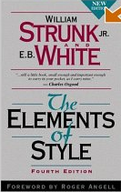
Your first draft is not your final draft!
The goal is to make the paper clear and readable
There is no excuse for spelling errors.
Double-check subject-verb agreement.
Make sure that you have been consistent throughout the paper.
If you are unsure of grammar usage, look it up!
From Writing for Computer Science by Justin Zobel

Slide 43
WS-DL Writing Process
You write a draft (or outline)
repeat {
We provide feedback
You make edits
You provide a revision
} until DONE
Pay attention to the feedback and learn from it
I don't want to be making the same style/grammar comments on all of your papers

Slide 44
A Few Style Comments

Slide 45
Writing Style
Be clear, simple, correct, interesting, direct
delete unneeded words, simplify sentence structure, establish logical flow
Be objective and accurate
primary objective is to inform, not entertain
Don’t use contractions or slang
From Writing for Computer Science by Justin Zobel

Slide 46
Style Specifics
Don’t use capitalization or quotation marks for emphasis
Use italics for emphasis or to highlight terms
but don’t italicize words unnecessarily
Avoid "this" without a noun after it, especially at the beginning of a sentence.
Bad: "This shows that we are fabulous”
Good: "This situation shows that we are fabulous"
From Writing for Computer Science by Justin Zobel and http://www.cs.ubc.ca/~tmm/writing.txt by Tamara Munzner

Slide 47
Use the Oxford Comma.
The Oxford comma is the final comma in a list of things (just before the "and")
apples, oranges, and bananas
I don’t care that MLA says not to use the Oxford comma. Use it.

Slide 48
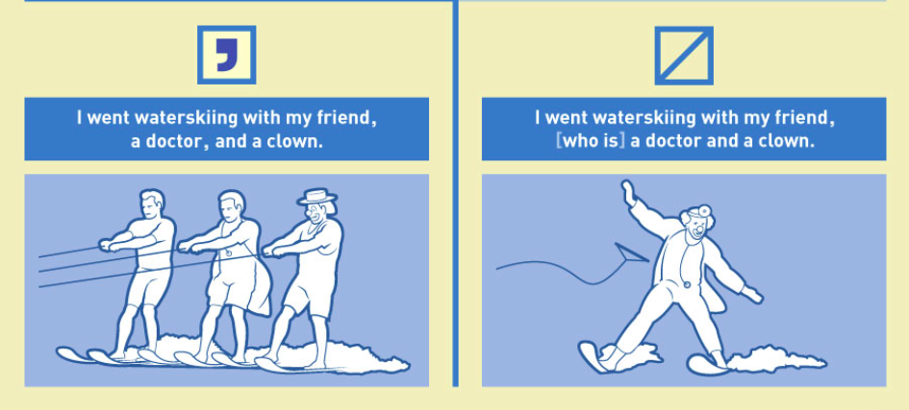
http://mentalfloss.com/article/61309/handy-guide-using-oxford-comma

Slide 49
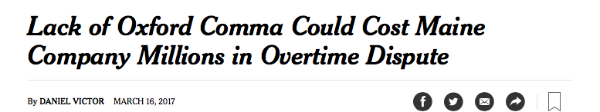
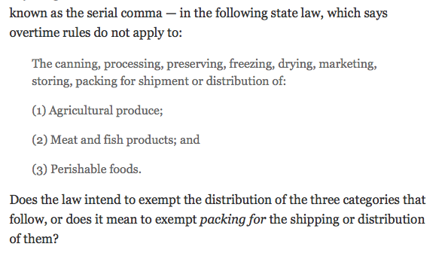
https://www.nytimes.com/2017/03/16/us/oxford-comma-lawsuit.html?_r=0

Slide 50
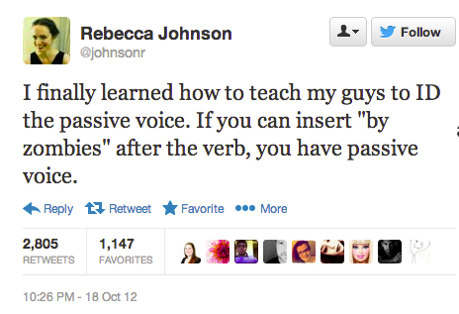
Avoid the passive voice.
The house was haunted (by zombies)
The experiment was run
The data was collected
The web page was archived
https://www.grammarly.com/blog/a-scary-easy-way-to-help-you-find-passive-voice/
Active voice emphasizes who is doing the action.
We collected the data
The Internet Archive captured the web page

Slide 51
Summary
Writing a paper is like telling a particular type of story.
Academic papers have a standard structure.
Your writing should be clear, simple, correct, interesting, direct, and objective.
Attention to detail in writing reflects attention to detail in research.

Slide 52
The talk was finished.

